Slide 1
INDUSTRIAL TRAINING AT MITRA INNOVATION
P. Thamilvaanan
2015CSC014

Slide 2
COMPANY BACKGROUND
Specialized in digital transformation, cloud enablement, and software development for ISVs, Enterprises and Entrepreneurs
Mr. Ashok Suppaiah (CEO), Mr. Darek Bell (COO) and Mr. Dammika Ganegama (MD) foundes this company in 2012
Specialized in the services which includes WSO2 middleware, cloud services such as AWS, Azure, GCP, DevOps and managed services, Techno log consulting and software developments (including app development, bespoke software development, and platform and product incubation)

Slide 3
PROJECTS
TASKS
Calculator
Making UI components upto template level
Creating a real project using those UI components
Front end and Back end
REACT – BASELINE – THEME (Research)
RESOURCE MANAGEMENT TOOL

Slide 4
CALCULATOR
TECHNOLOGIES USED:-
Springboot for Back end
Angular Js for Front end
CHALLENGES:-
Short time period

Slide 5
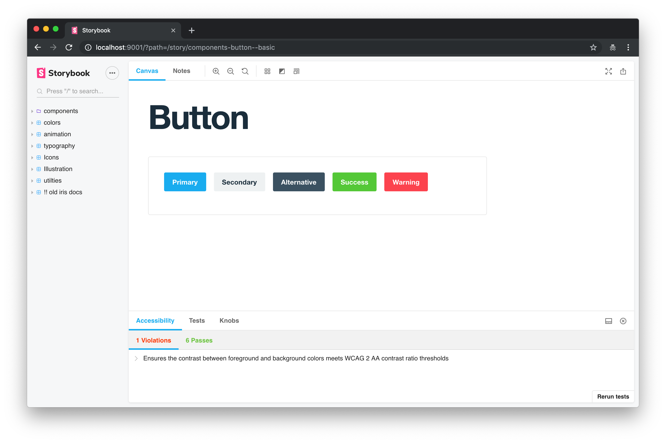
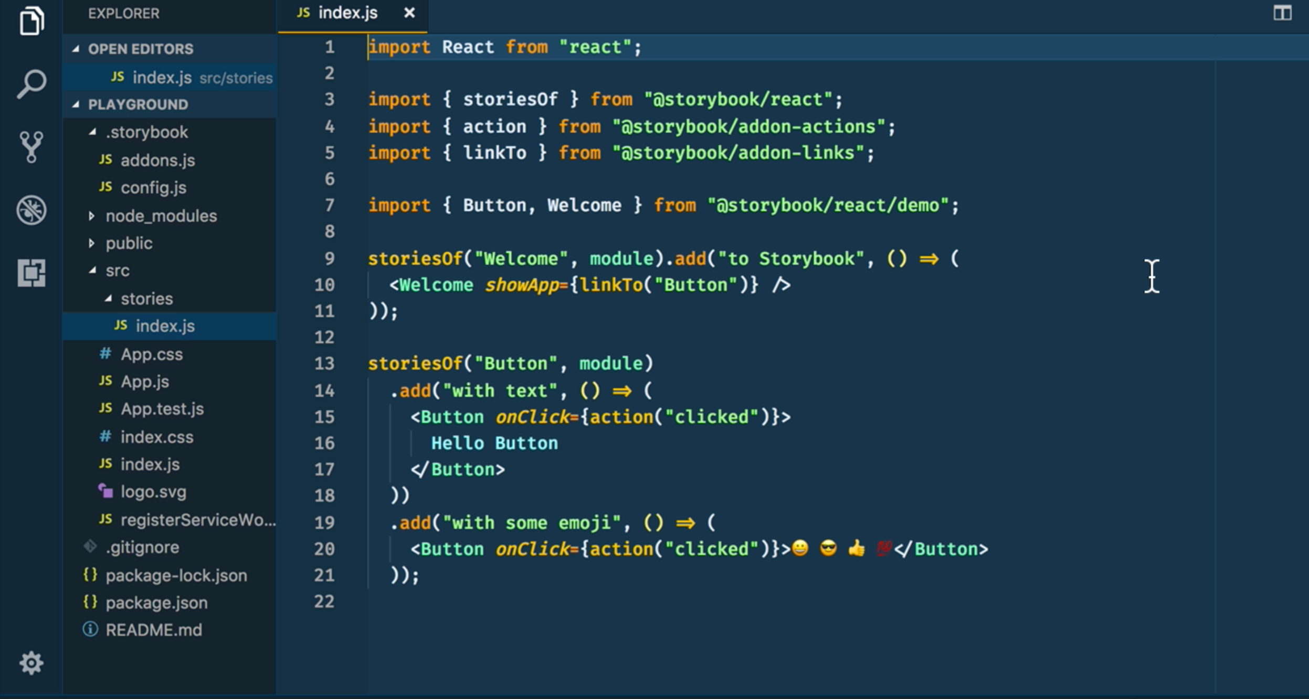
Making UI components
*Components should be customized

Slide 6
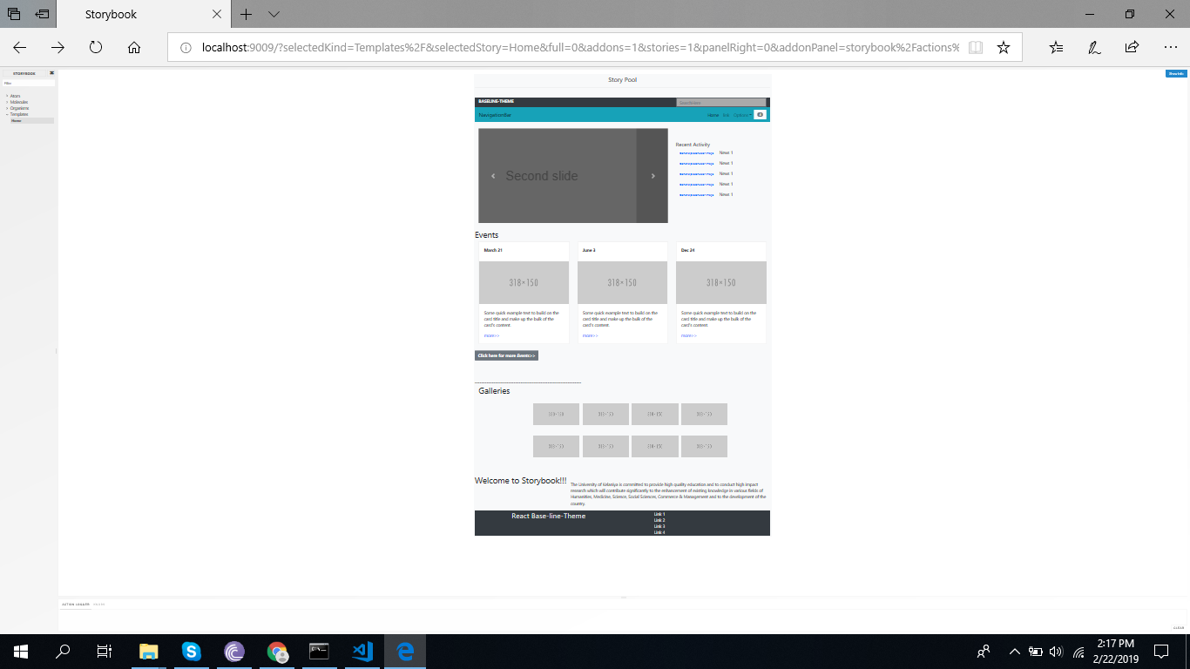
Template_level

Slide 7
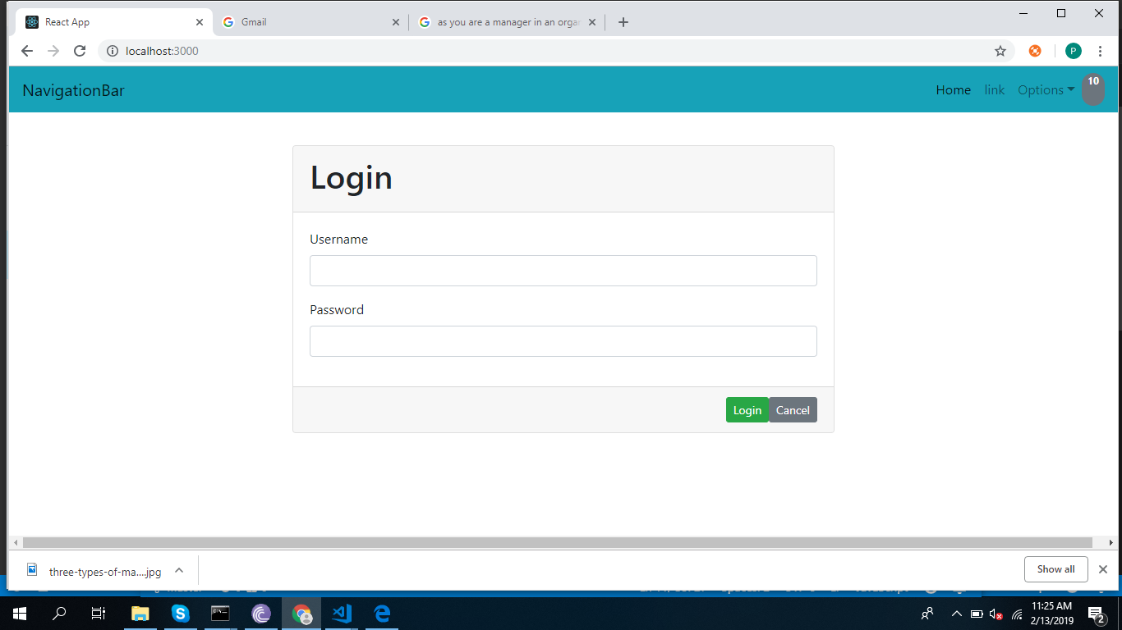
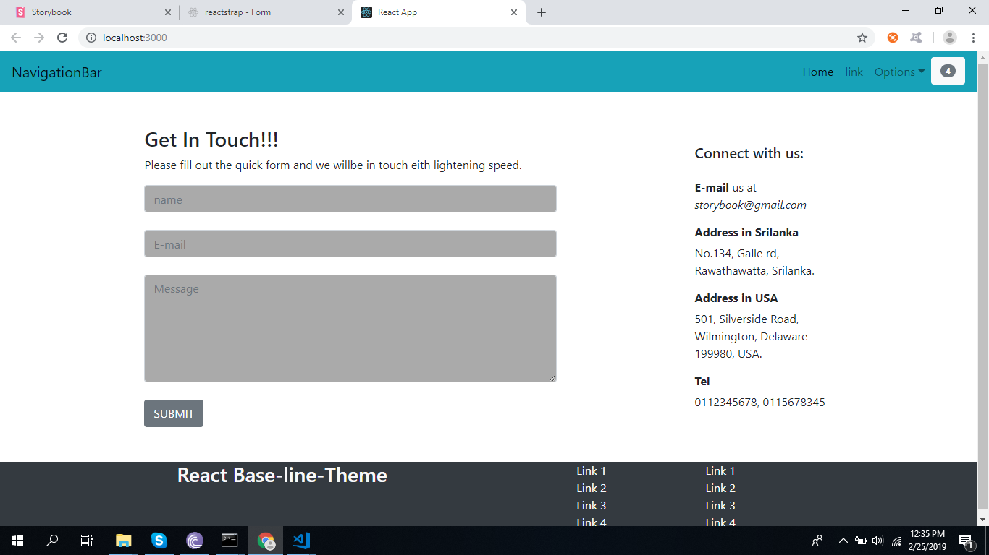
*Created Real_pages using Components which are already done

Slide 8
TECHNOLOGIES USED:-
React Js
Sass for styling
Story_book Tool
CHALLENGES:-
Changing Requirements

Slide 9
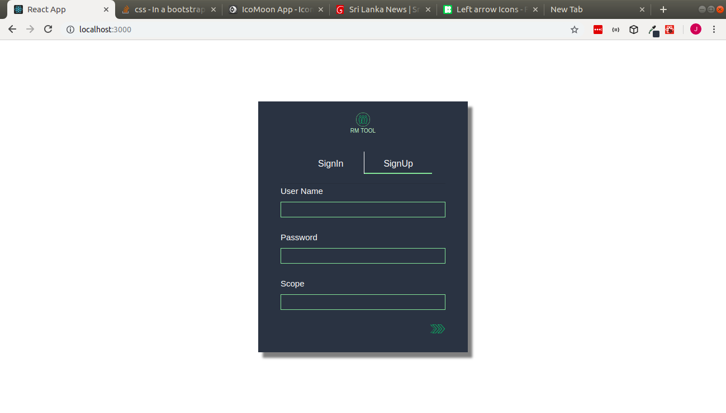
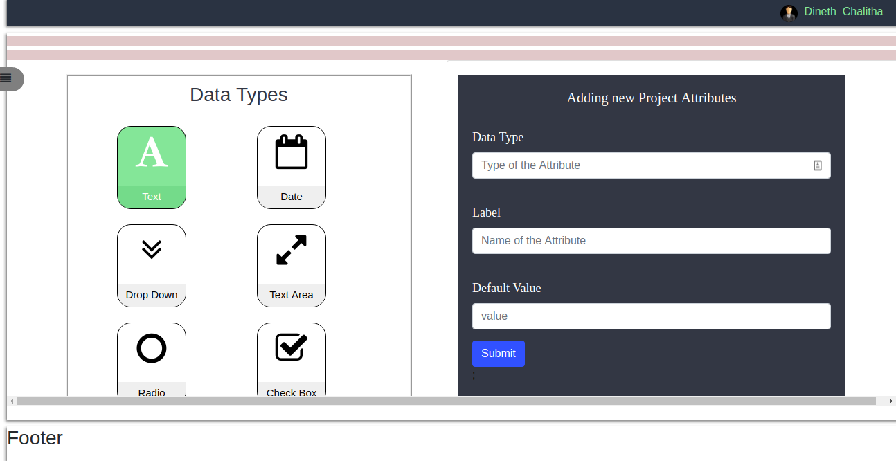
RESOURCE MANAGEMENT TOOL Allocating available resources for the certain projects. Sign in through google authentication.

Slide 10
TECHNOLOGIES USED:-
React Js
Node Js
MongoDB
CHALLENGES:-
Unclear and changing requirements
Short period

Slide 11
OTHERS
Boot camp on React js
Clean coders session
Tech talk on Git best practices

Slide 12
WORKING ENVIRONMENT
Supportive colleagues.
Encouraging supervisors.
Multicultural environment.
Flexible working style.

Slide 13
THANK YOU

