Slide 1
Industrial Training
At
Wavenet International (Pvt) Ltd
by Bhagya Udayangani (2015/CSC/016)

Slide 2
Nature of the Training Programme
Importance of industrial training
Experience of actual working environment
Enhance knowledge and skill about subject area
Experience with professionals
CSC321SC8 - Industrial Training
Academic year 2016/2017 - June 2019

Slide 3
How did I…
join
CSC321SC8 - Industrial Training
Academic year 2016/2017 - June 2019

Slide 4
Background of Organization
Vision - To be the customer interaction and value added services partner of choice for global communications service providers.
Mission - Build the enablers that allow carries to simplify, digitize and orchestrate their networks.
Market hold

Slide 5
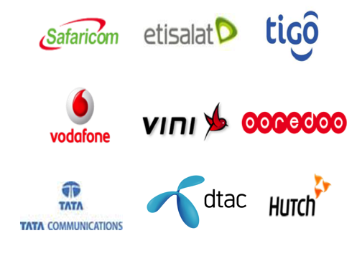
Customers
CSC321SC8 - Industrial Training
Academic year 2016/2017 - June 2019

Slide 6
Departments of the Organization
Finance department
Technical department
Engineering operations
Technology strategy
QA and Process department
Commercial department
HR department
Product Management department
Corporate Communication department
CSC321SC8 - Industrial Training
Academic year 2016/2017 - June 2019

Slide 7
Details of Methods & Techniques, Tools & Equipment Used

Slide 8
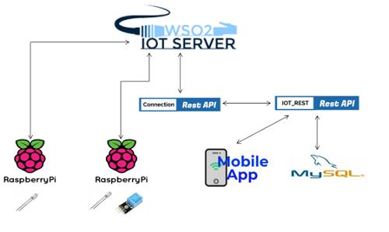
IOT Research Project(Old)

Slide 9
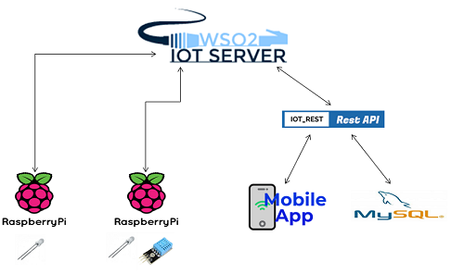
IOT Research Project(New)

Slide 10
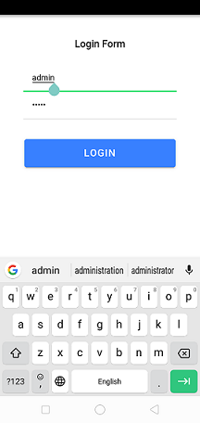
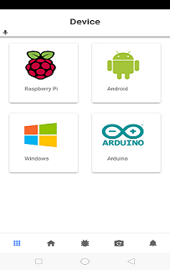
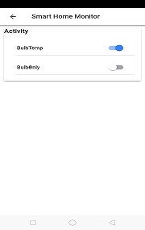
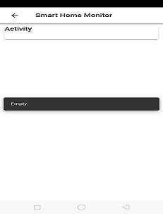
Mobile Application

Slide 11
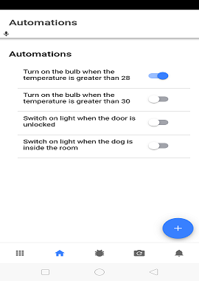
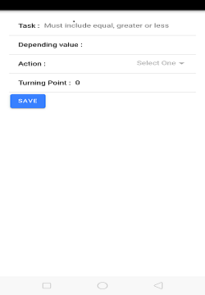
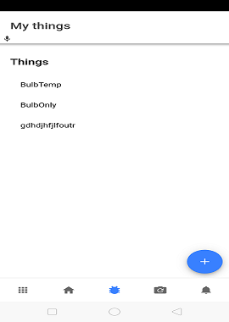
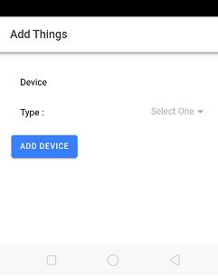
Continue……..

Slide 12
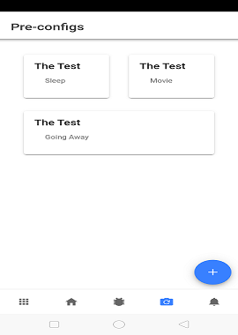
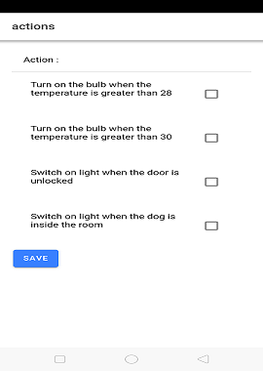
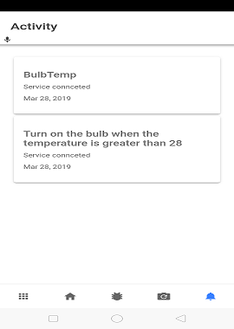
Continue………….

Slide 13
Details of new Learning
Working with servers.
SVN - SubVersioN.
Languages - Ionic 4, Angular CLI, Erlang
CSC321SC8 - Industrial Training
Academic year 2016/2017 - June 2019

Slide 14
Q&A

Slide 15
Thank You!

