Slide 1
Industrial Training at REDOT Pvt Ltd
By:
W.R.Isuri Nadeeshanee Kalugalla
2015/CSC/023

Slide 2
Company Profile
Founded in 2012 focusing on providing highly scalable e-business solutions with innovative approaches and advanced methodologies
Organizational Expertise
Onsite Service
Mobile Applications
Networking
Web Development
Search Engine Optimization
Graphics

Slide 3
Training Acquired
Well-planned training
Web design using Html, CSS, Sass, JavaScript & jQuery, Bootstrap
Impressive effects that include in a web page
Web design using packages (npm and Bower)
Backend development in PHP, MySQL, ES6
Development of web applications in MEAN stack
Layout design in Adobe Photoshop

Slide 4
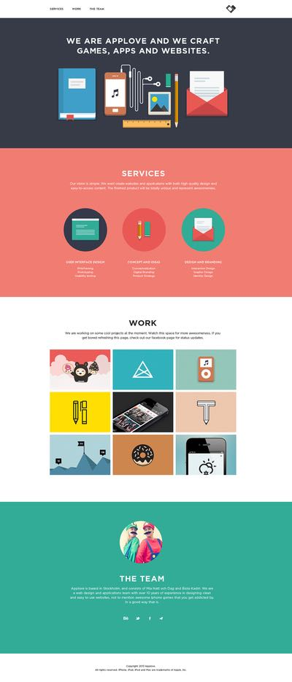
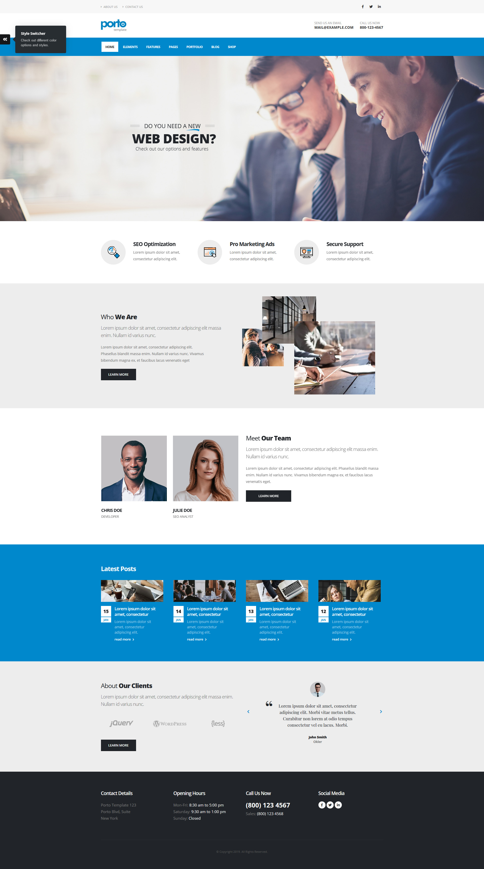

Slide 5
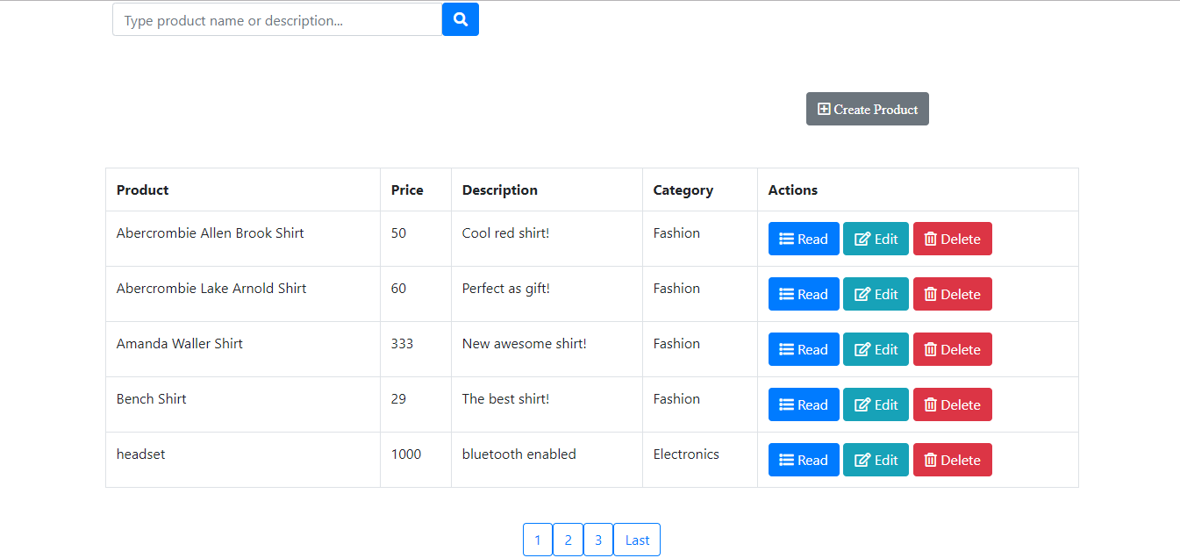
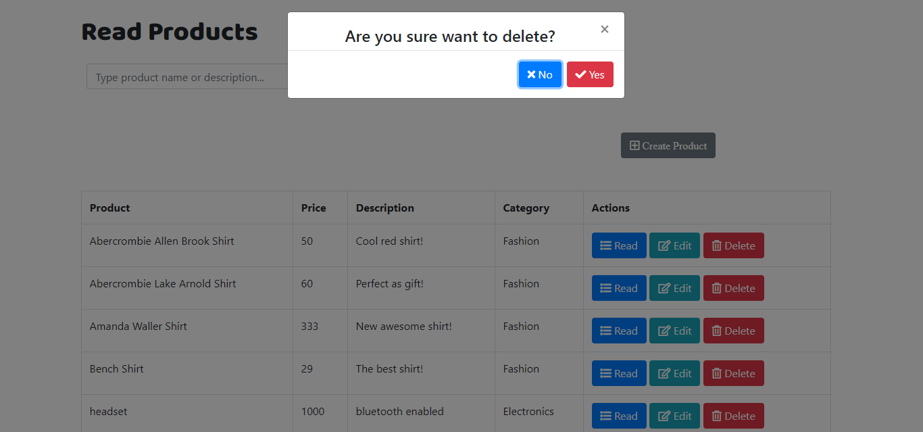
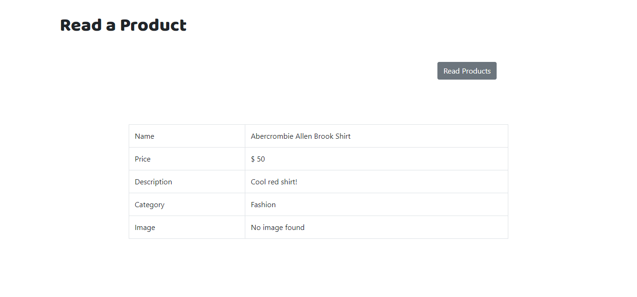
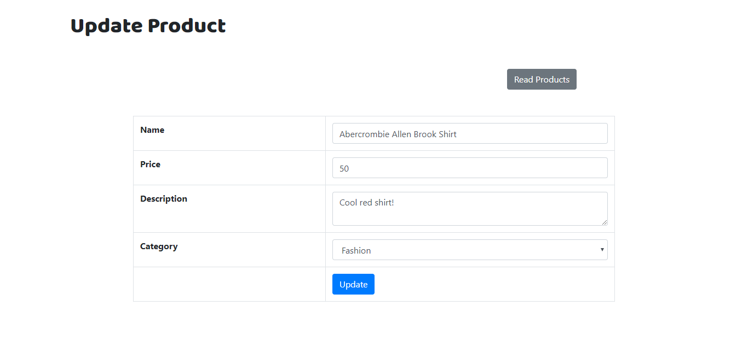

Slide 6
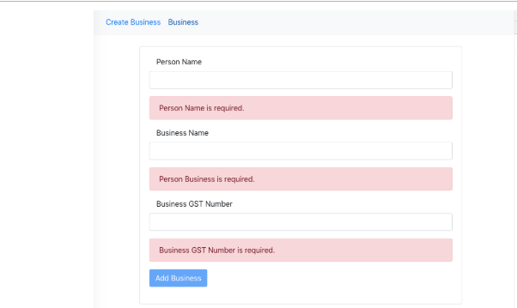

Slide 7
Learning Outcome
Grabbed many opportunities
improved soft skills and knowledge
good exposure to new technologies
Self-awareness
Self-management
Adaptability
Improved communication skills

Slide 8
Conclusion
Gained the opportunity to identify and observe how engineering is applicable in the real world industry
Captured a wide scope of knowledge which will aid in building the future academic and professional career in a better way

Slide 9
Thank You

